Slide 1

Name of Solution: IntelliED Short Description: Enabling educators to leverage a data-driven approach to improve learning outcomes and equitably accelerate growth for all learners inside 1 million classrooms in India.

Slide 2

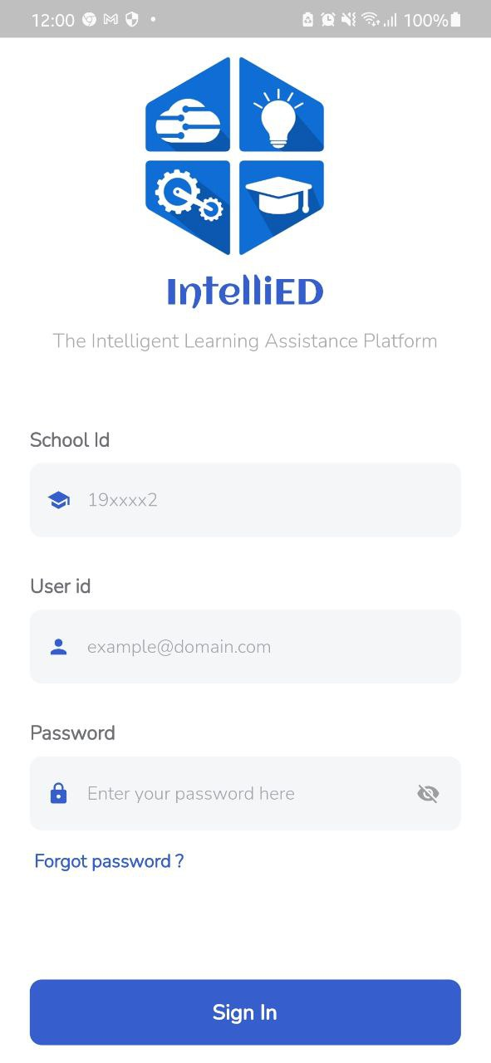
What is IntelliED? IntelliED is a mobile-based software solution that provides easy data management to K-12 schools & enable educators to leverage a data-driven approach to improve learning outcomes and equitably accelerate growth for all learners.

Slide 3
What will IntelliED do?
Track Students’ Progress Digitally
Efficiently track academic performance, co-curricular progress, attendance patterns, time spent on online learning resources, and classroom engagement, etc. in real time with the application.
Data-Driven Decision Making
Leverage a Data-Driven approach, which involves converting raw data points into actionable insights with the help of AI & Analytics based tools, to make smarter decision while delivering precise feedback & designing personalized learning plans.
Modernize Your Campus
Upgrade and modernize your campus experience by using digital tools to leverage student learning data to equitably accelerate the growth, track performance and improve learning in modern-day classrooms.

Slide 4
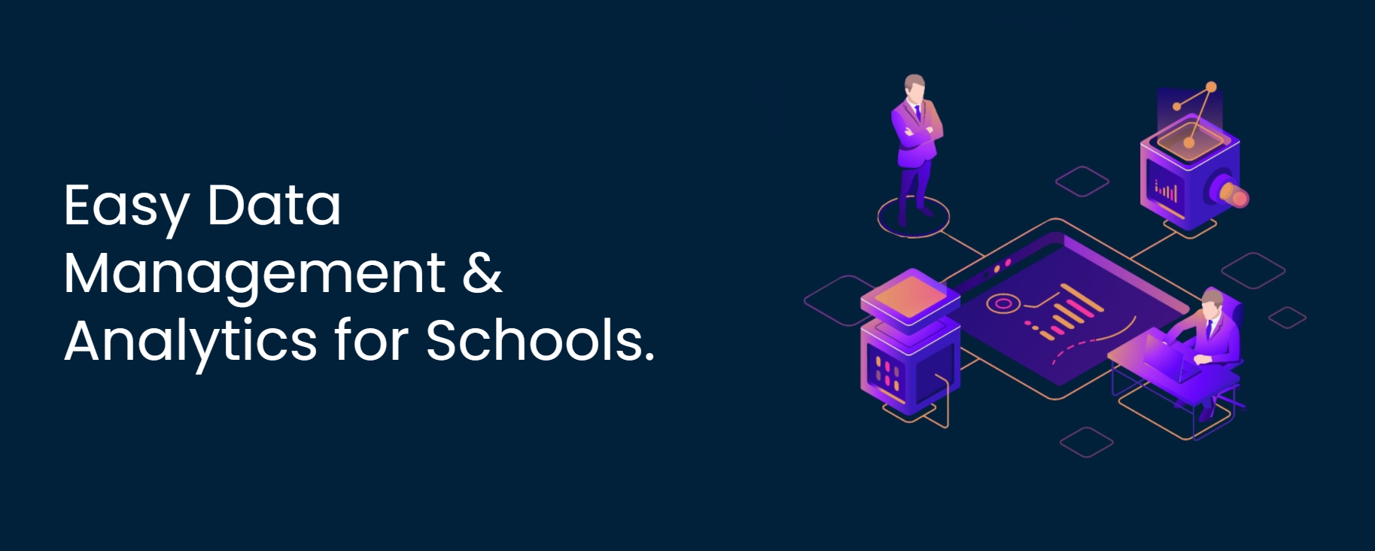
The Problem
◉ Schools generate large sums of data from which they can extract insights to make smarter learning decisions and improve student outcomes.
◉ Currently, schools have their data disintegrated, soiled under various sources due to which creating reports for a large number of students, analysing them, and providing precise feedback with personalized learning plans becomes a complex and time-consuming task for educators.
◉ Moreover, the resources required to gather and utilize data to improve learning outcomes remains limited to elite urban schools. Hence, majority of schools are unable to leverage data to improve learning outcomes.
Hence, we want to provide schools with IntelliED, an easy to use and cost-effective digital solution that allows them to effectively manage students’ data and extract insights from it to improve learning outcomes for students.

Slide 5

The Solution
◉ IntelliED provides schools an efficient way of gathering, integrating and managing the entire student data from multiple sources within a single platform.
◉ The solution help educators convert raw data into actionable insights so that they can deliver precise feedback & design personalized learning plan for their students.
◉ IntelliED uses Machine Learning models trained on prior student performance data to predict future outcomes so that educators can address learning gaps and forehandedly devise
personalized learning strategies for struggling students especially those
from vulnerable backgrounds.
◉ The tool helps educator set-up an Early-Warning-System (EWS) that
notifies them in real-time whenever a student seems to be falling
behind so that they can quickly develop support strategies and
resources to help students get back on track - before it’s too late.
◉ Will save 30-40 hours per month for educators and admins by helping
them to manage data, send reminders, automate evaluation and
instantaneously generate analytics.

Slide 6


Main Features
Easy, Quick & Secure Access to Data
Data Driven Decision Making
A digital solution powered by Azure Services that be accessed with existing
personal devices devices, sparing schools the expense of purchasing any new hardware.
Transform your institution’s data into actionable insights to understand what
variables make things happen and make smarter decisions earlier in the learning progression.

Slide 7

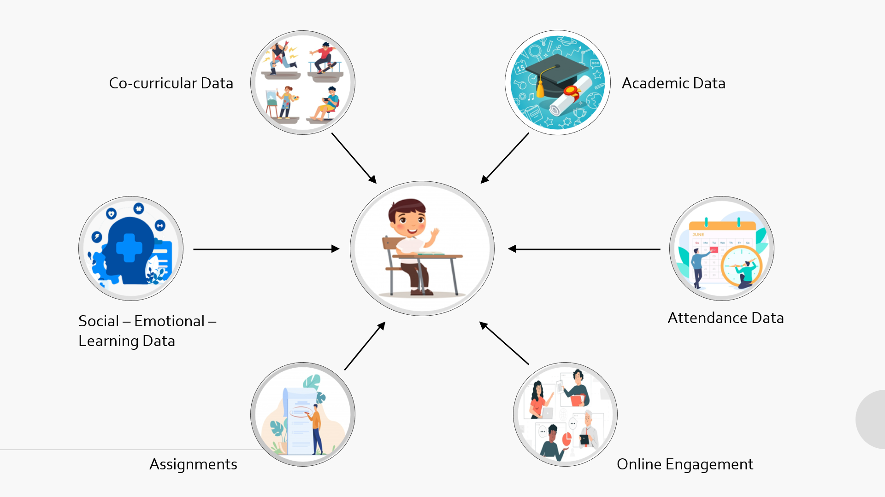
Main Features
Early Warning
System (EWS)
Holistic View
of Students
Notifies educators in real-time
whenever a student seems to be
falling behind so that educators can develop additional strategies to help students get back on track.
Discover insights from student data to
predict future outcomes like forecast
their academic performance, predict attendance patterns, anticipate a learner's likelihood of completing a course, and estimate the chances of dropout among other things. thereby providing a holistic view of students.

Slide 8





How does it work?
Azure Machine Learning Deployed Endpoints
Student’s Data
Azure Storage
✪ Performance Forecasts
✪ Recommendations
✪ Intervention plans
✪ Support strategies
Personalized Feedback
Azure Analytics

Slide 9
Azure Technologies Used
Azure Machine Learning Studio
Azure Studio
Azure Analytics

Slide 10
Other advantages of IntelliED
☑ Can be accessed on personal devices under low-resource setting (both android & iOS)
☑ Easy to use without much technical expertise
☑ Help teachers to cater learning needs of a diverse cohort
☑ Reduces human reporting errors
☑ Automates routine administrative tasks & Saves time
☑ Eliminates the use of paper

Slide 11
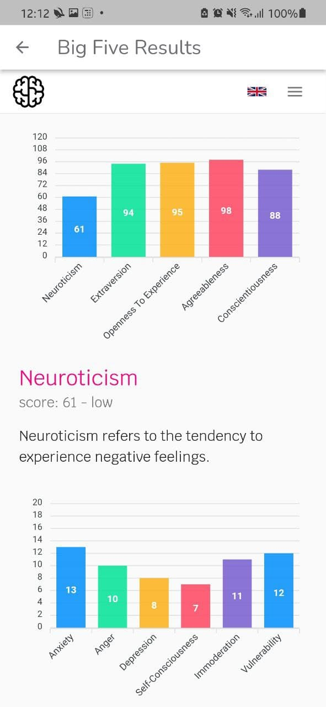
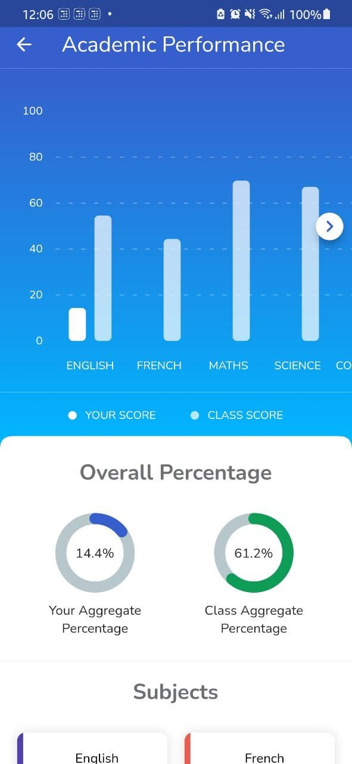

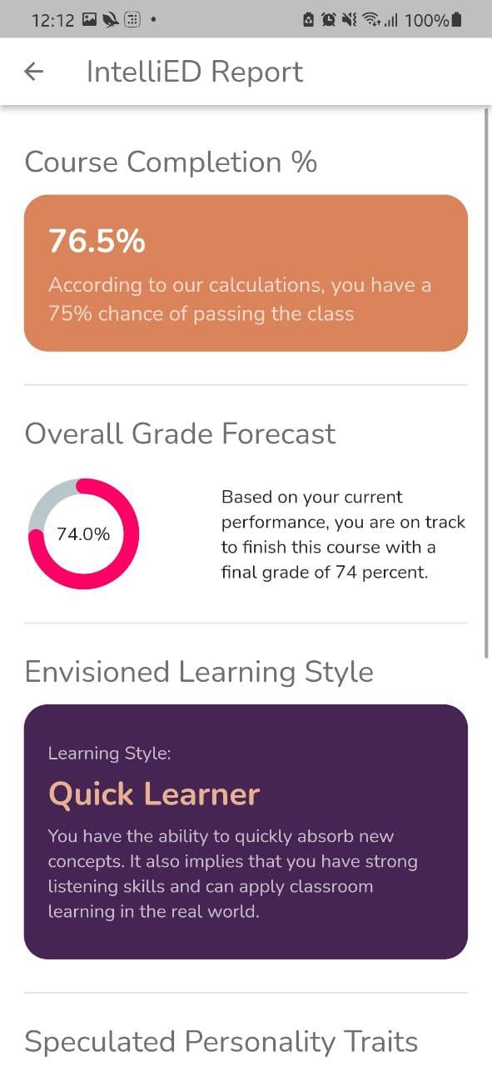
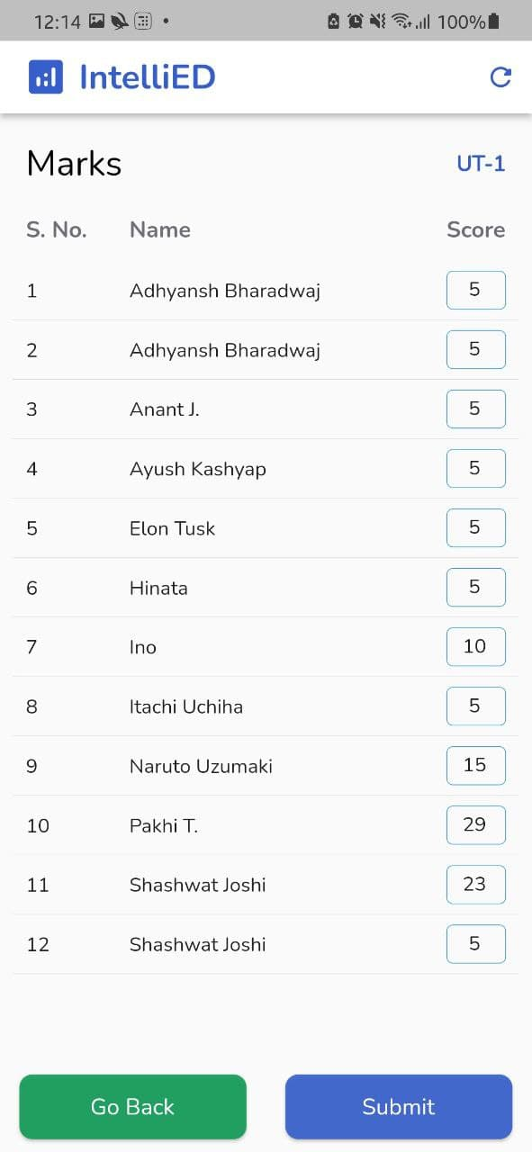
Wireframe Designs

Slide 12
Thank You

